Slide 1
Unit 6 – Device Management

Slide 2
Introduction
A function of OS
Responsible for managing all the hardware devices of the computer system
Both storage devices and I/O devices
Device Management generally performs:
Installing devices, component drivers and related software dependencies
Configuring the device to perform at its peak
Implementing security measures and processes

Slide 3
Classification of I/O devices
The I/O units which consist mechanical components are called I/O devices e.g. hard-disk drive, printer etc.
There are two types of devices
Block devices or Machine readable
Character devices or User readable

Slide 4
Classification of I/O devices (contd.)
Block devices or Machine readable
Stores information in fixed-sized blocks, each one with its own address
Read or write is possible independent to other blocks-direct access
Example: disk
Character devices or User readable
Delivers or accepts a stream of characters without regard to any block structure
It is not addressable and does not have any seek operation
Example: keyboards, mice, terminals, line printers, network interfaces, and most other devices that are not disk-like.

Slide 5
Device Controllers
A controller is a collection of electronics that can operate a bus or a device
A single controller can handle multiple devices; some devices have their own built-in controller
The controller has one or more registers for data and signals
The processor communicates with the controller by reading and writing bit patterns in these registers

Slide 6
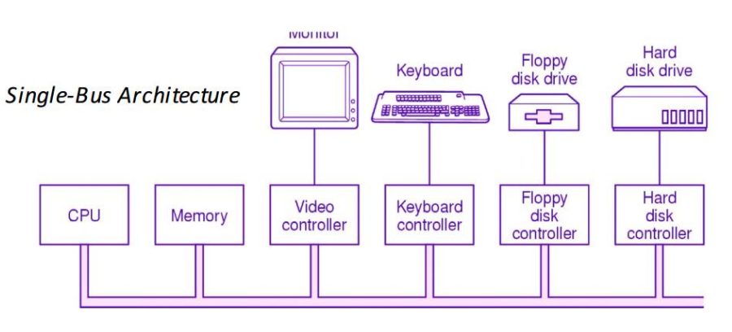
Device Controllers (contd.)

Slide 7
Memory Mapped I/O
Device controller have their own register (Control Register) and Data Buffer for communicating with the CPU
Each control register is assigned a unique memory address to which no memory is assigned
OS allocates buffer in memory and informs I/O device to use that buffer to send the data to the CPU
It is used for high-speed I/O devices
CPU communicated with control register and data buffer:
Using I/O ports
Using Memory mapped I/O
Using hybrid system

Slide 8
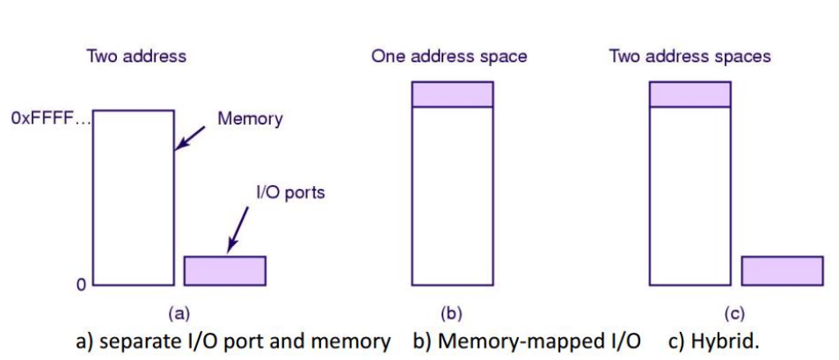
Memory Mapped I/O (contd.)

Slide 9
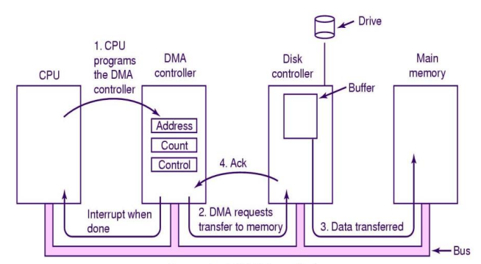
Direct Memory Access (DMA)
A process for data transfer between memory and I/O, controlled by an external circuit called DMA controller
There is no involvement of CPU

Slide 10
Working Principle of DMA

Slide 11
Interrupts
Mechanism that enables a device to notify a CPU – Interrupts
It forces CPU to stop what it is currently doing and start to do another task
Interrupts is the signal sent by devices to the CPU
Types of Interrupts
Hardware Interrupts
Software Interrupts
Traps

Slide 12
Hardware Interrupts
Generated by hardware devices
A signal to the CPU is sent to interrupt as hardware needs some services of the OS
Services requested may be transferring the data from drive to memory or acknowledging a new received data during process execution

Slide 13
Software Interrupts
Generated by Programs
A signal to the CPU is sent to interrupt as software needs some services of the OS using system call
Traps
Generated by CPU itself
A signal by the CPU that indicates some error or condition has occurred for which the help of OS is needed

Slide 14
Goals of I/O software
Device Independence
Error Handling
Uniform Naming
Synchronous and Asynchronous Transfer
Buffering

Slide 15
Device Independence
It should be possible to write programs that can access any I/O device without having to specify the device in advance
A key concept in the design of I/O software
A program that reads a file as input should be able to read a file on a floppy disk, on a hard disk, or on a CD-ROM, without having to modify the program for each different device

Slide 16
Error Handling
In general, errors should be handled as close to the hardware as possible
If the controller discovers a read error,
It should try to correct the error itself if it can.
If it cannot, then the device driver should handle it, perhaps by just trying to read the block again

Slide 17
Uniform Naming
The name of a file or a device should simply be a string or an integer and not depend on the device in any way
All files and devices are addressed the same way: by a path name
A floppy disk can be mounted on top of the directory /usr/ast/backup so that copying a file to /usr/ast/backup/monday copies the file to the floppy disk

Slide 18
Synchronous and Asynchronous transfer
Synchronous – blocking
After a read system call the program is automatically suspended until the data are available in the buffer
Asynchronous – interrupt driven
the CPU starts the transfer and goes off to do something else until the interrupt arrives
It is up to the operating system to make operations that are actually interrupt-driven look blocking to the user programs

Slide 19
Buffering
Often data that come off a device cannot be stored directly in its final destination
For example, when a packet comes in off the network, the operating system does not know where to put it until it has stored the packet somewhere and examined it
Buffering involves considerable copying and often has a major impact on I/O performance

Slide 20
Handling I/O
Programmed IO
Interrupt Driven IO
IO using DMA

Slide 21
Programmed I/O
CPU does all the work
The data are exchanged between processor and I/O module
The processor executes a program that gives direct access of the I/O operations
The processor has to check each I/O device in sequence and asks if it needs to communicate with the processor

Slide 22
Interrupt driven
The data exchange using terminal or peripheral by signal
A program interrupt will be set for the transmission
Processor is not busy like in programmed I/O, so system throughput increases
Hardware support is needed in interrupt driven

Slide 23
I/O using DMA
DMA uses an additional hardware – DMA controller
DMA controller can take over the system bus from CPU
The process done by CPU is done by DMA

Slide 24
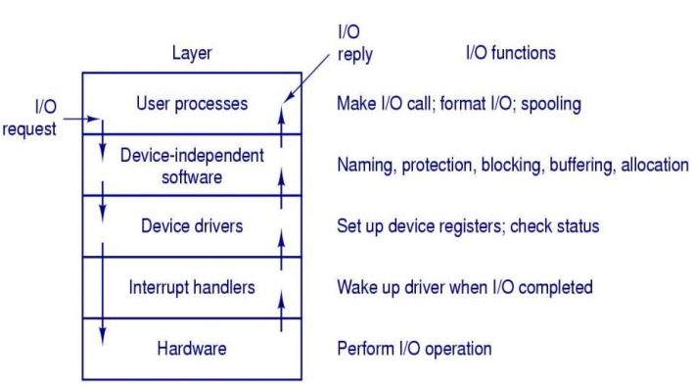
I/O software Layers

Slide 25
Interrupt Handlers
Also known as Interrupt Service Routine (ISR)
Block the driver until the I/O has completed and the interrupt occur
The interrupt-handler determines the cause of the interrupt and performs the necessary processing

Slide 26
Device Driver
Special kind of software program that helps hardware to communicate with OS
Accept read and write requests from the device independent software above it
Initialize the devices if necessary.
Manage power requirement and log events.
It checks the status of devices- in use or free.
Decides which command to issue if there is command queue

Slide 27
Device Independent Software
Perform the I/O functions that are common to all devices
Provide a uniform interface to the user-level software

Slide 28
Disks
Disks come in a variety of types
The most common ones are
Magnetic disks (hard disks and floppy disks)
They are characterized by the fact that reads and writes are equally fast,
which makes them ideal as secondary memory (paging, file systems, etc.)
Arrays of these disks are sometimes used to provide highly-reliable storage
For distribution of programs, data, and movies, various kinds of optical disks (CD-ROMs, CD-Recordable and DVDs) are also important

Slide 29
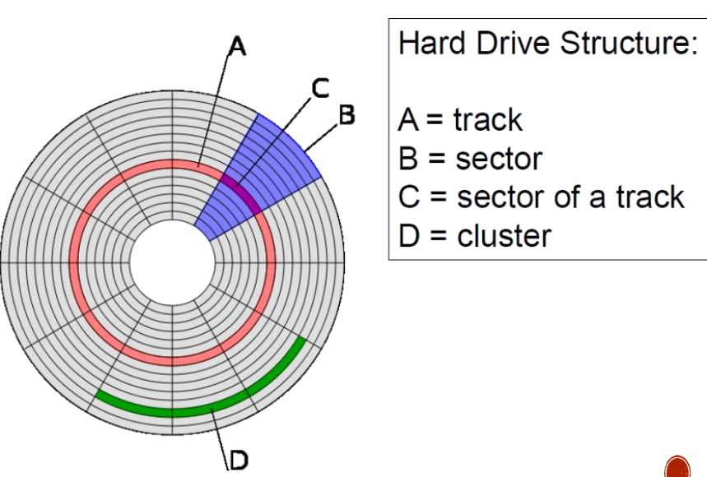
Disk Structure
Magnetic Disks
Disk surface is divided into number of logical block called sectors and tracks
The term cylinder refers to all the tracks at particular head position in hard disk

Slide 30
Disk Scheduling
FCFS
SSTF
SCAN
C-SCAN
LOOK
C-LOOK

Slide 31
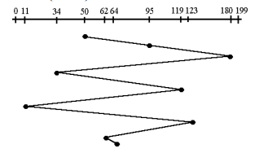
First Come First Serve
Given the following queue: 95, 180, 34, 119, 11, 123, 62, 64 with the Read-write head initially at the track 50 and the tail track being at 199 let us now discuss the different algorithms.

Slide 32
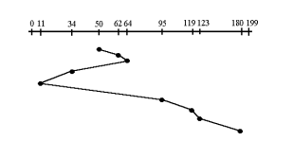
Shortest Seek Time First
Given the following queue: 95, 180, 34, 119, 11, 123, 62, 64 with the Read-write head initially at the track 50 and the tail track being at 199 let us now discuss the different algorithms.

Slide 33
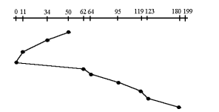
SCAN
Given the following queue: 95, 180, 34, 119, 11, 123, 62, 64 with the Read-write head initially at the track 50 and the tail track being at 199 let us now discuss the different algorithms.

Slide 34
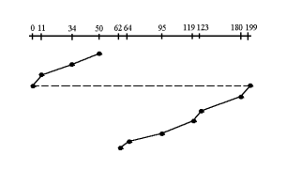
C-SCAN
Given the following queue: 95, 180, 34, 119, 11, 123, 62, 64 with the Read-write head initially at the track 50 and the tail track being at 199 let us now discuss the different algorithms.

Slide 35
LOOK & C-LOOK

Slide 36
Disk Formatting
Process to configure the data storage devices such as hard drive when used for the first time
It is usually required
when a user is using an OS for the very first time
when there is space issue and we need additional space for the storage
It has capability to erase the data within the disk

Slide 37
RAID
Redundant Array of Independent (Inexpensive) Disks
Multiple disks or increased performance, data redundancy
Increase the mean time to failure
Mean time to repair – exposure time when another failure could cause data loss
Mean time to data loss based on above factors

Slide 38
RAID (contd.)
Disk striping uses a group of disks as one storage unit
RAID schemes improve performance and improve the reliability of the storage system by storing redundant data
Mirroring or shadowing (RAID 1) keeps duplicate of each disk
Striped mirrors (RAID 1+0) or mirrored stripes (RAID 0+1) provides high performance and high reliability
Block interleaved parity (RAID 4, 5, 6) uses much less redundancy
RAID within a storage array can still fail if the array fails, so automatic replication of the data between arrays is common
Frequently, a small number of hot-spare disks are left unallocated, automatically replacing a failed disk and having data rebuilt onto them

